Slide 1
Introduction to Microprocessor and Microcontroller
Farhan Sadaf
Lecturer, Dept. of CSE

Slide 2
Why do we need to learn Microprocessors/Microcontrollers?
The microprocessor is the core of computer systems.
Its’ not an overstatement if it says that, today there is no electronic gadget on the earth which is designed without a Microcontroller. Ex: communication devices, digital entertainment, portable devices etc…
Nowadays many communication, digital entertainment, portable devices are controlled by them.

Slide 3
Why do we need to learn Microprocessors/Microcontrollers? (cont’d.)
Personal information products: Cell phone, Pager, Watch, Pocket recorder, Calculator
Laptop components: Mouse, Keyboard, Modem, Fax card, Sound card, Battery charger
Home appliances: Door lock, Alarm clock, Thermostat, Air conditioner, TV remote, VCR, Refrigerator, Exercise equipment, Washer/dryer, Microwave oven
Industrial equipment: Temperature/pressure controllers, Counters, Timers, RPM Controllers
Toys: Video games, Cars, Dolls, etc.

Slide 4
Why do we need to learn Microprocessors/Microcontrollers? (cont’d.)
So, A good designer should always know what type of controller he/she is using, their architecture, advantages, disadvantages, ways to reduce production costs and product reliability etc…

Slide 5
Microprocessor
Microprocessor and CPU are used interchangeably.
A microprocessor is a multipurpose, programmable, clock-driven, register based electronic device that reads binary instructions from a storage device called memory, accepts binary data as input and processes data according to those instructions and provides results as output.

Slide 6
Microprocessor (cont’d.)
A CPU built into a single VLSI chip is called a microprocessor.
It is a general-purpose device and additional external circuitry are added to make it a microcomputer.
The microprocessor contains arithmetic and logic unit (ALU), control unit, Instruction register, Program counter (PC), clock circuit (internal or external), reset circuit (internal or external) and registers. But the microprocessor has no on chip I/O Ports, Timers, Memory etc.
For example, Intel 8085 is an 8-bit microprocessor and Intel 8086/8088 a 16-bit microprocessor.

Slide 7
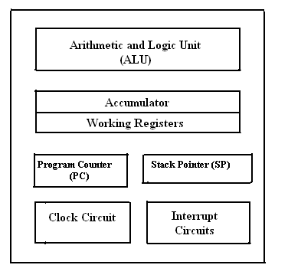
Microprocessor (cont’d.)
Fig. Block diagram of a Microprocessor.

Slide 8
Microprocessor (cont’d.)
Arithmetic and Logic Unit (ALU)
It is the place where actual computations take place.
Consist of circuits which performs arithmetic operations over data received from memory and capable to compare to compare numbers.

Slide 9
Microprocessor (cont’d.)
Control Unit (CU)
The coordination and control of a computer is the sole responsibility of the CU.
It interrupts the instructions fetched into the computers, determines what data if any are needed, where it is stored, where to store the result of the operations.
It ensured that according to the fetched instructions the right operation is done on the right data at the right time.

Slide 10
Microprocessor (cont’d.)
Registers
Registers are temporary storage locations inside microprocessor that hold data and address.

Slide 11
Microprocessor (cont’d.)
Program counter (PC)
It is commonly known as IP (Instruction Pointer) in 8086, is a register in microprocessor that contains the address of the next instruction to be executed.

Slide 12
Microprocessor (cont’d.)
Stack Pointer (SP)
It is a small register that stores the address of the last program/instruction request in a stack.

Slide 13
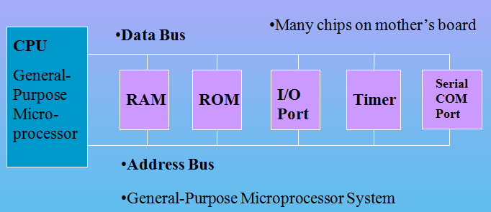
Microprocessor (cont’d.)
CPU for Computers
No RAM, ROM, I/O on CPU chip itself
Example: Intel's x86, Motorola’s 680x0

Slide 14
Microcontroller
Micro Controller
Very Small
A mechanism that controls
the operation of a machine

Slide 15
Microcontroller (cont’d.)
A microcontroller is a highly integrated single chip, which consists of on chip CPU (Central Processing Unit), RAM (Random Access Memory), EPROM/PROM/ROM (Erasable Programmable Read Only Memory), I/O (input/output) – serial and parallel ports, timers, interrupt controller.
For example, Intel 8051 is 8-bit microcontroller and Intel 8096 is 16-bit microcontroller.

Slide 16
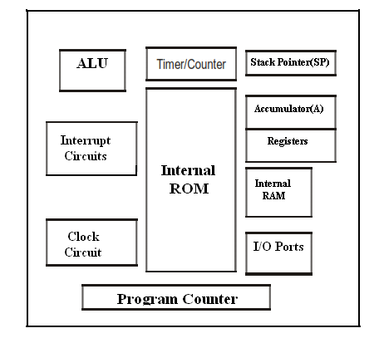
Microcontroller (cont’d.)
Fig. Block Diagram of a Microcontroller

Slide 17
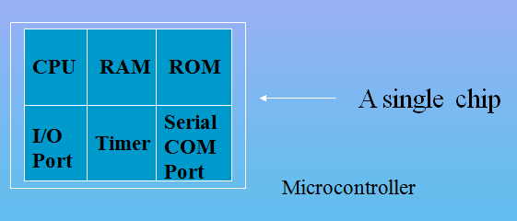
Microcontroller (cont’d.)
A smaller computer
On-chip RAM, ROM, I/O ports...
Example: Motorola’s 6811, Intel’s 8051, Zilog’s Z8 and PIC

Slide 18
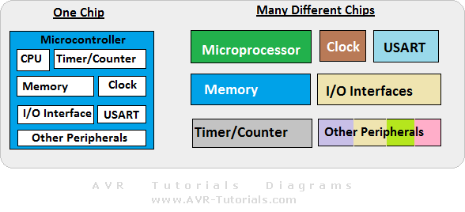
Microprocessor vs. Microcontroller

Slide 19
Microprocessor vs. Microcontroller (cont’d.)
Microprocessor | Microcontroller
CPU is stand-alone, RAM, ROM, I/O, timer are separate | CPU, RAM, ROM, I/O and timer are all on a single chip
Designer can decide on the amount of ROM, RAM and I/O ports | Fixed amount of on-chip ROM, RAM, I/O ports
Expensive | For applications in which cost, power and space are critical
General-purpose | Single-purpose (control-oriented)
High processing power | Low processing power
High power consumption | Low power consumption
Instruction sets focus on processing-intensive operations | Instruction sets focus on control and bit-level operations
Typically 16/32/64 – bit | Typically 8/16 bit
Typically deep pipeline (5-20 stages) | Typically single-cycle/two-stage pipeline

Slide 20
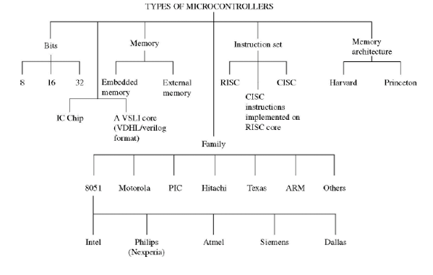
Types

Slide 21
Criteria for Choosing a Microcontroller
1. Meeting the computing needs of the task at hand efficiently and cost effectively.
Speed
Power consumption
The amount of RAM and ROM on chip
The number of I/O pins and the timer on chip
How easy to upgrade to higher performance or lower power-consumption versions.
Cost per unit

Slide 22
Criteria for Choosing a Microcontroller (cont’d.)
2. Availability of software development tools, such as compilers, assemblers, and debuggers.
3. Wide availability and reliable sources of the microcontroller.
The 8051 family has the largest number of diversified (multiple source) suppliers
Intel (original)
Atmel
Philips/Signetics
AMD
Infineon (formerly Siemens)
Dallas Semiconductor/Maxim

Slide 23
Microcontroller Architectures
Memory
Address Bus
0
Program + Data
Von Neumann
Architecture
CPU
Data Bus
2^{n}
Memory
Address Bus
0
Program
CPU
Fetch Bus
Harvard
Architecture
Address Bus
0
Data
Data Bus

Slide 24
Microcontroller Architectures(cont’d.)
Von-Neumann Architecture
Only one bus.
Used for both data transfer and instruction fetches.
Cannot be performed at same time.
Harvard Architecture
Separate data and instruction buses.
Transfers to be performed simultaneously on both buses.

Slide 25
Applications of microcontrollers
Cell phone
Pager
Watch
Calculator
video games
Alarm clock
Air conditioner
TV remote
Microwave oven
Washing machines
An electronic smart weight display system
Robotic system
An anti-lock braking system monitor

Slide 26
Thank You!

